Slide 1
Programming Concepts III
HILT 2018

Slide 2
Method Chaining
Do a series of tasks in order (inside to out)
task_three(task_one(data).task_two)
First, task.one executes, then result.trytwo
task_three(task_one(data).task_two)
task_three(result.task_two)
task_three(result)
result

Slide 3
What is OOP?
A way of thinking about the world and of organizing your code for efficiency.
Objects are complex entities (which we sometimes call "data structures") with qualities and abilities.
In an object-oriented programming language, we work with complex objects rather than simple "primitives" like numbers and strings.

Slide 4
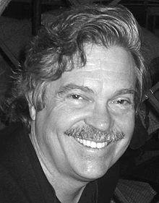
Object Orientation
(Nearly) Everything is an Object
Objects "communicate" by sending and receiving messages
Objects have their own memory
Every object is an instance of a class
Alan Kay
Object-oriented Programming
Graphical User Interface
3D Graphics
ARPANET (what became the Internet)

Slide 5
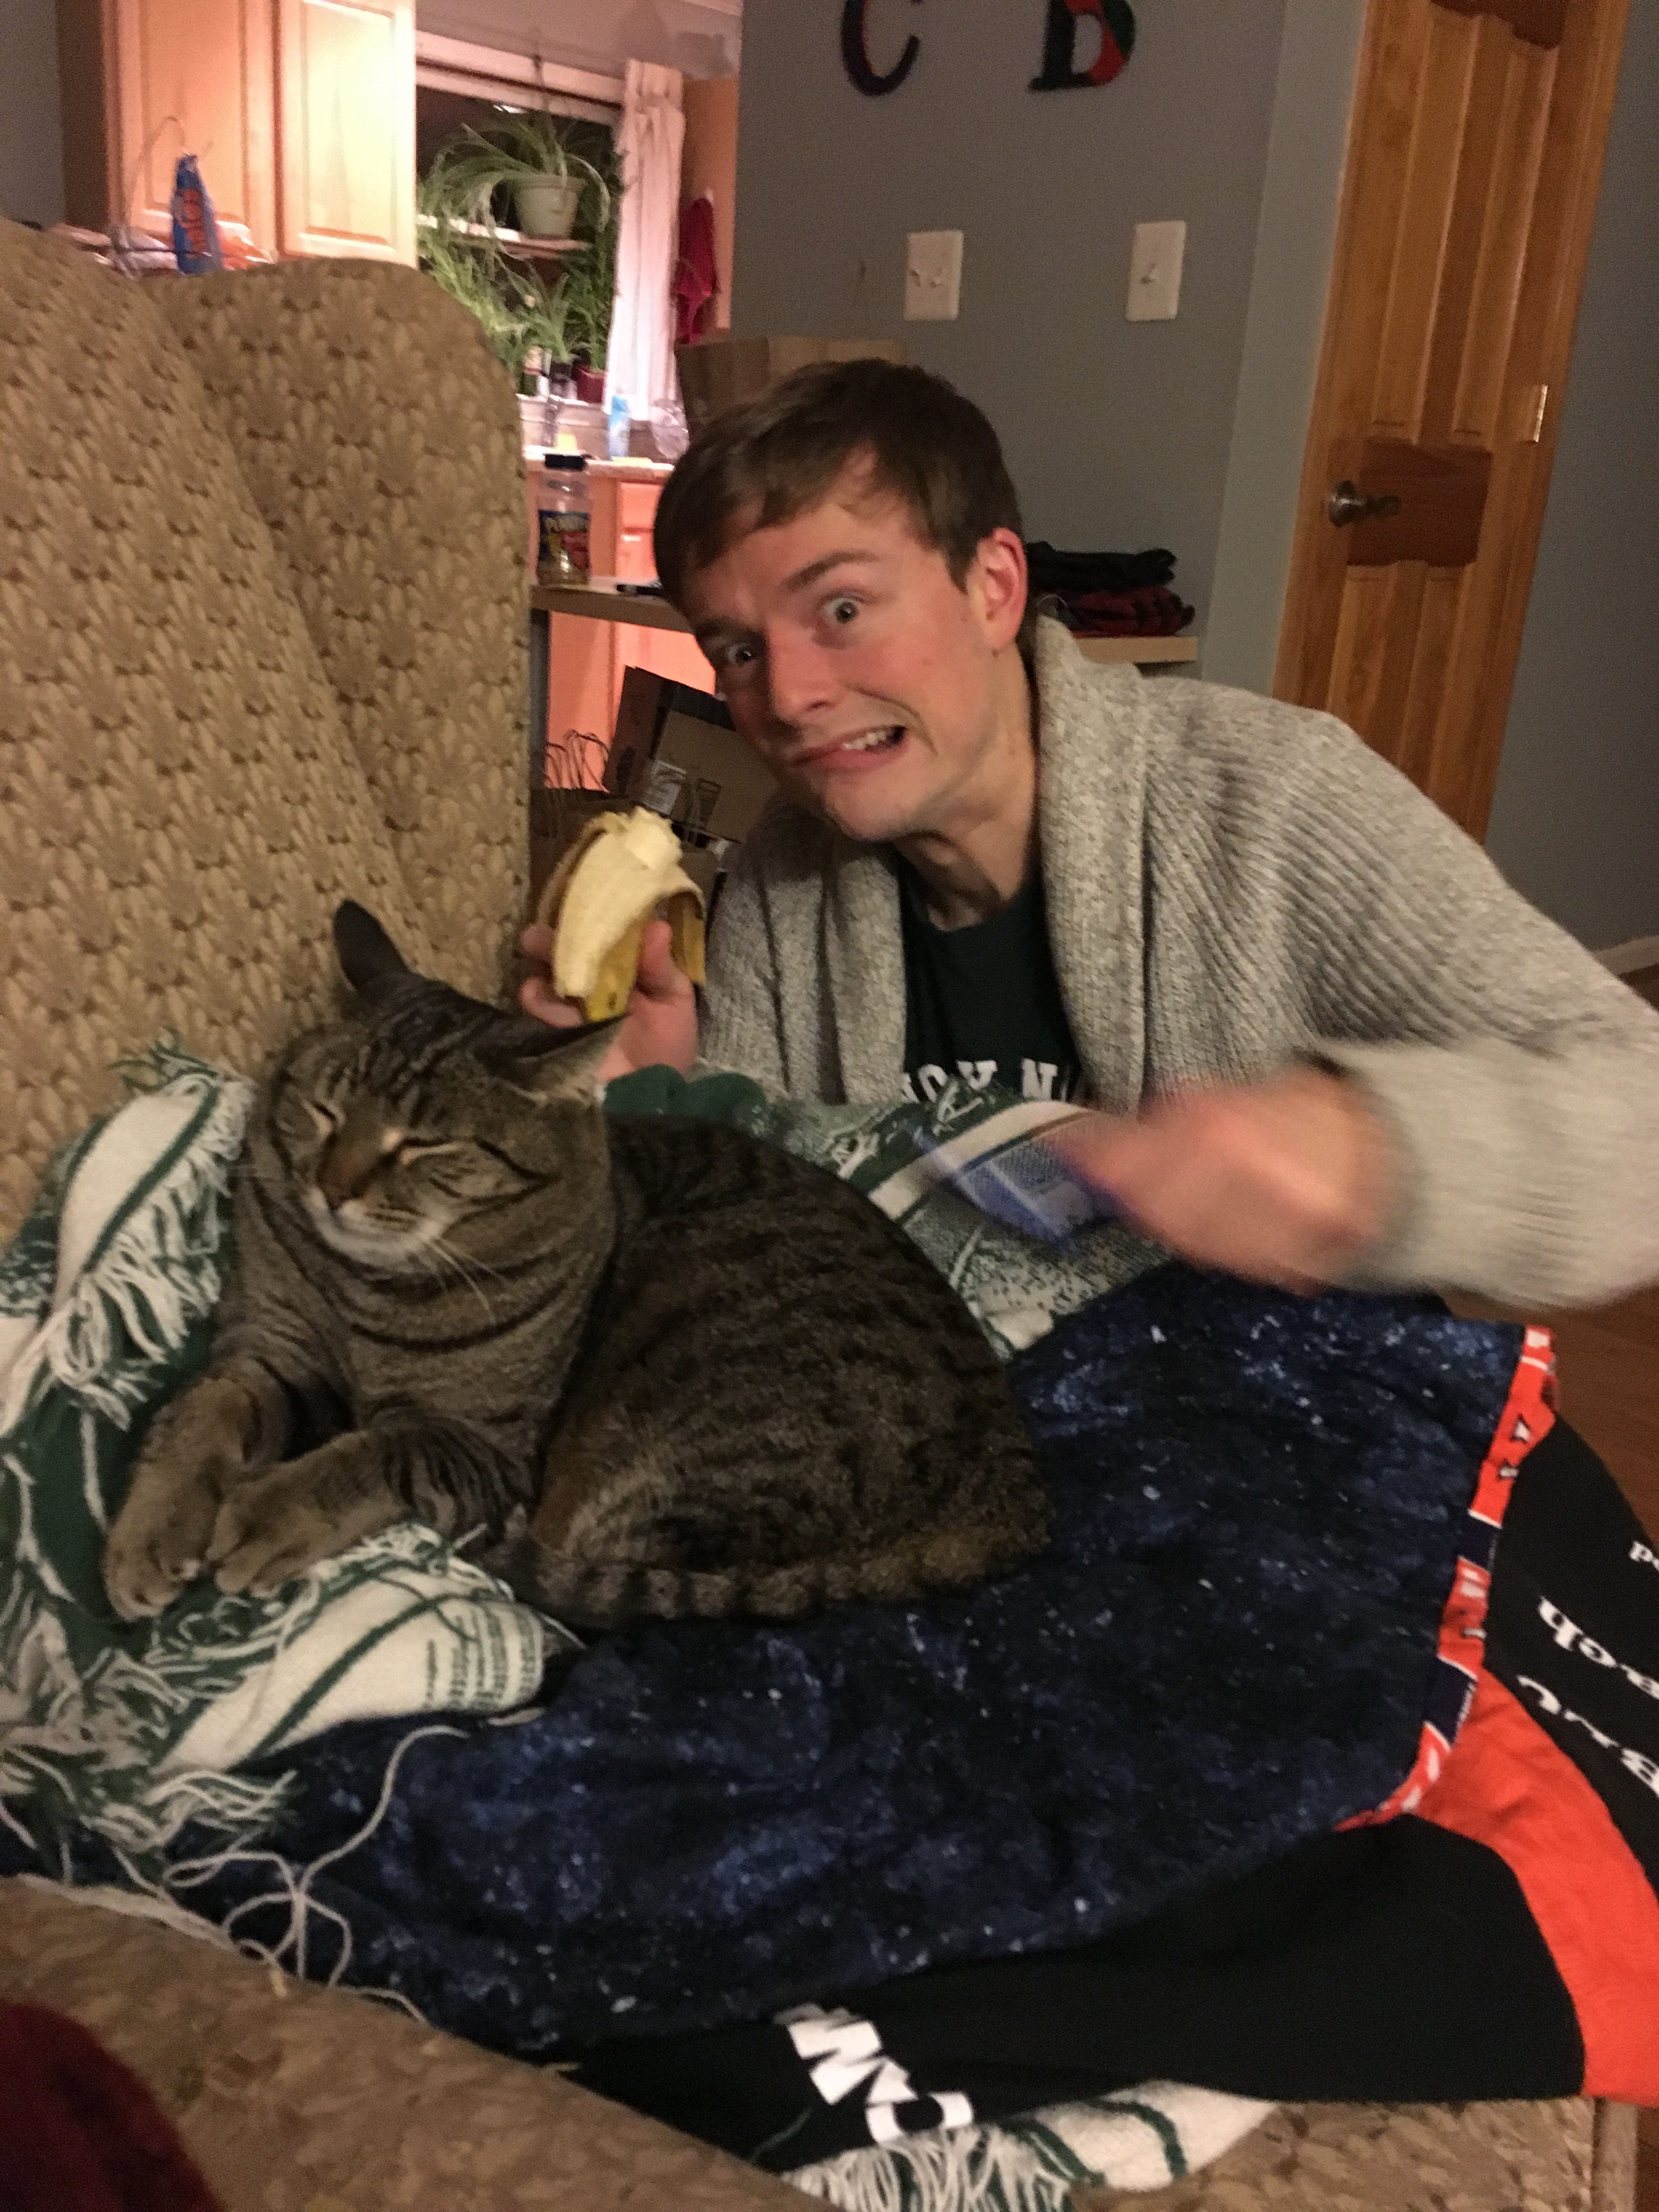
Object
Take this cat…
It has qualities (attributes)
sleepy
evil?
standoffish
And can do things (methods)
walk
eat
meow
scream
yowl

Slide 6

Object
Take this Dog…
What are its qualities? (attributes)
What can it do? (methods)

Slide 7
Coffee Class
class Coffee:
pass
c = Coffee()
print(c)
#<Coffee:0x007ffb1d0b6290>
=> nil
Notes:
Coffee class with nothing in it.

Slide 8
Coffee Class
class Coffee:
def __init__(self):
print("Coffee is created")
c = Coffee()
Coffee is created
=> #<Coffee:0x007ffb1d09ba08>
Notes:
Initialize class is what happens when something new is made

Slide 9
Variable
Defines attribute characteristics
What things of the class’ type have
Breed
Model Year
Favorite Ice Cream

Slide 10
Coffee Class
class Coffee:
def __init__(self):
self.temperature = 0
self.flavor = 'sweet, smoky, Sumatran'
myCoffee = Coffee()
c.flavor
=> sweet, smoky, Sumatran
c.temperature
=> 0
Some attributes here!

Slide 11
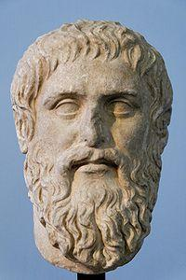
Classes and instances
Classes are archetypes
Instances are particular objects
Notes:
Ethan and Brandon are both instances of class Human.
It’s a way of organizing and understanding the relationships among groups of things.

Slide 12
Class
Describes the generic characteristics of a single type of an object
What things are of this type are
Dog
Vehicle
Baby

Slide 13
Classes and Instances
Classes
Template for an object
Describes state
Describes behavior
Used to create many instances
Instances
Discreet instantiation of a class
Shares behavior with other instances
Notes:
Classes are the abstract template.
Instances are single units. Have all the behaviors of a class.

Slide 14
Coffee Class
class Coffee:
def __init__(self, temp=0, flavor='bland'):
self.temperature = temp
self.flavor = flavor
ethans_coffee = Coffee(80, 'spicy')
ethans_coffee.temperature
=> 80
ethans_coffee.flavor
=> spicy
brandons_coffee = Coffee(90)
brandons_coffee.temperature
=> 90
brandons_coffee.flavor
=> spicy
What happened? How were we interacting with attributes?
Notes:
defaults! Also note the different instances

Slide 15
Instance
A specific incarnation of a class
Rin Tin Tin
garbage truck
the neighbor's kid

Slide 16
Classes and Instances
Classes
Book
Author
Instances
Harry Potter
“Turn of the Screw”
Dune
JK Rowling
Henry James (yuck)
Frank Herbert
Notes:
Classes are the abstract template.
Instances are single units. Have all the behaviors of a class.

Slide 17
Classes Continued Objects have actions and attributes associated with them
Classes
Harry Potter
JK Rowling
Actions
Read
Shelve
Open
Write
Walk
Eat
Attributes
Length
Genre
Title
Height
Age
Cool?
Notes:
Classes are the abstract template.
Instances are single units. Have all the behaviors of a class.

Slide 18
Coffee Class
class Coffee:
def __init__(self, temp=0, flavor='bland'):
self.temperature = temp
self.flavor = flavor
ethans_coffee = Coffee(80, 'spicy')
ethans_coffee.temperature
=> 80
ethans_coffee.flavor
=> spicy
brandons_coffee = Coffee(90)
brandons_coffee.temperature
=> 90
brandons_coffee.flavor
=> spicy
What happened? How were we interacting with attributes?
Notes:
Review of instances

Slide 19
Methods
Defines a behavioral characteristic
What the things of the class's type do.
Chase
Drive
Talk
The "verbs"

Slide 20
Methods
Defined within a class
Store instructions to execute on attributes
keyword def: starts a method, tabbing closes it
Every method evaluates to something
return keyword required (unless we don't want anything back)
use # or """a_comment""" at the beginning of a to write a comment (Python will ignore everything on the line after the # )
Similar to functions, which we worked with already!

Slide 21
Manipulating Values
within our Coffee class
def change_temp(self, temp):
self.temperature = temp
brandons_coffee = Coffee()
brandons_coffee.change_temp(120)
print(myCoffee.temperature)
What is the scope of temp? of self.temperature?

Slide 22
Existential Tests
within our coffee class
def is_hot(self):
if self.temperature > 160:
return True

Slide 23
Parentheses
class Person:
def __init__(self, first_name, last_name):
self.first = first_name
self.last = last_name
def speak(self):
print("My name is " + self.first + "" + self.last)
me = Person("Brandon", "Walsh")
you = Person("Ethan", "Reed")
me.speak <= does not work
you.speak() <= works
attributes do not need parens. methods do.

Slide 24
Why do this? Simplicity and Organization
class Person:
def __init__(self, first_name, last_name):
self.first = first_name
self.last = last_name
def speak(self):
print('My name is ' + self.first + ' ' + self.last)
me = Person('Brandon', 'Walsh')
you = Person('Ethan', 'Reed')
me.speak
you.speak

Slide 25
Could have been…
me_first_name = 'Brandon'
me_last_name = 'Walsh'
print('My name is ' + me_first_name + ' ' + me_last_name)
you_first_name = 'Ethan'
you_last_name = 'Reed'
print('My name is ' + you_name + ' ' + you_name)
But notice :
The variables and the print statement aren't connected, even though those concepts are all related
How much code we have to retype each time.
How the code is more confusing.
If it breaks, it will only give a line number. A class would also give us a method – useful for saying "oh the speak function is broken!"

Slide 26
Ways I have used classes recently…
read in all text files
make a Text() object from each, which has a title, date, author, genre, vocabulary list
3. from all those Text() objects, combine them into one big Corpus() object
4. This gives me organize certain text level functions like text.tokenize(), which splits things into words, from corpus level functions – corpus.topic_model() or corpus.visualize().
When working at scale they make things much easier to grasp.

Slide 27
In the wild…
from bs4 import BeautifulSoup
soup = BeautifulSoup(some_HTML)
soup.text
int("4")
BeautifulSoup is an object someone else made.
It has certain attributes we can get (all the text on a web page).
We can also do certain things to it (like pull out all the links).
We construct a beautiful soup object by giving it something it needs to build up the object.

Slide 28
Documentation
Explain what the code is intended to do
Reminders to yourself on what it does
If you can't explain it easily, rewrite the code

Slide 29
Exercise
Write a Dog class.
Give it three methods.
Give it three attributes.
Share with your neighbor

Slide 30
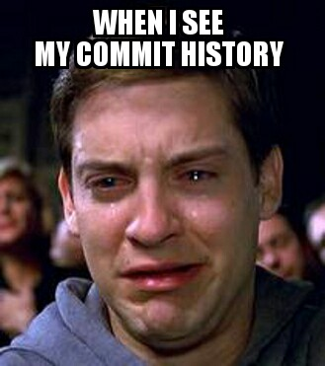

Slide 31
Questions?

